Slide 1
Project 3
1. Task: Rating prediction
2. Data:
User ratings for some businesses
Extra user information
Extra business information
3. Evaluation: RMSE

Slide 2
Project 3
1. Task: Rating prediction
2. Data:
User ratings
Extra user information
Extra business information
3. Evaluation: RMSE

Slide 3
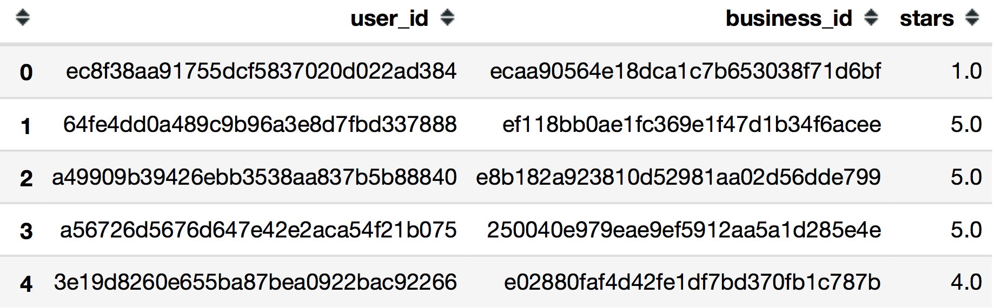
Project 3
User ratings:

Slide 4
Project 3
1. Task: Rating prediction
2. Data:
User ratings
Extra user information
Extra business information
3. Evaluation: RMSE

Slide 5
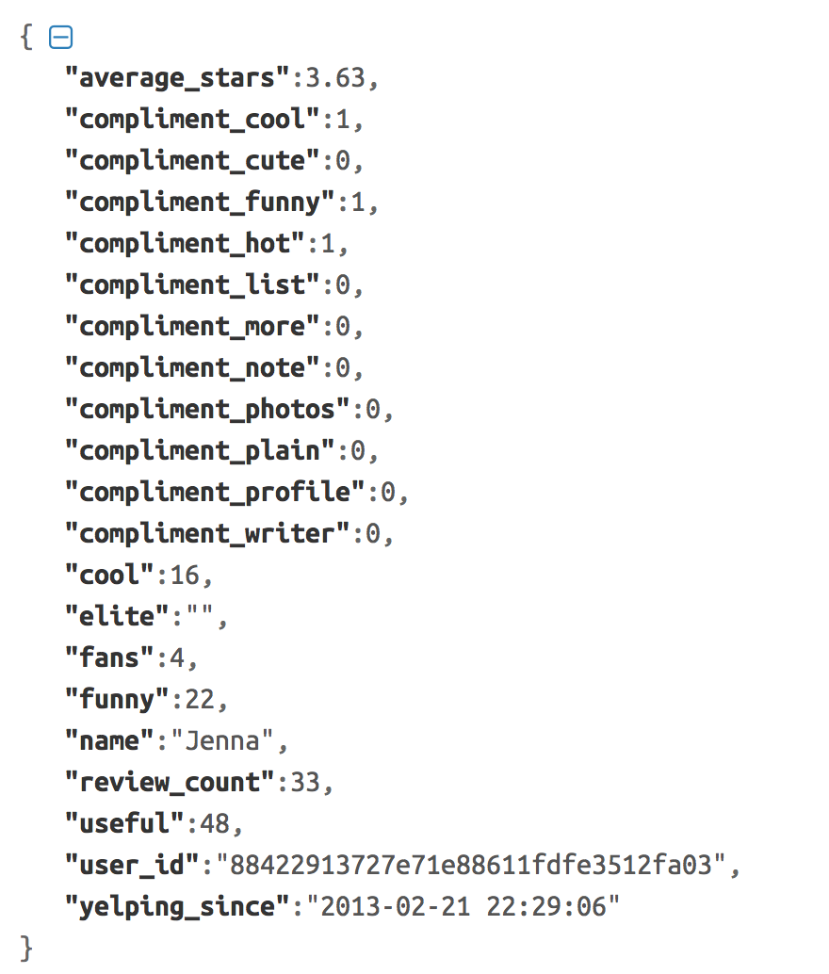
Project 3
Extra user information

Slide 6
Project 3
1. Task: Rating prediction
2. Data:
User ratings
Extra user information
Extra business information
3. Evaluation: RMSE

Slide 7
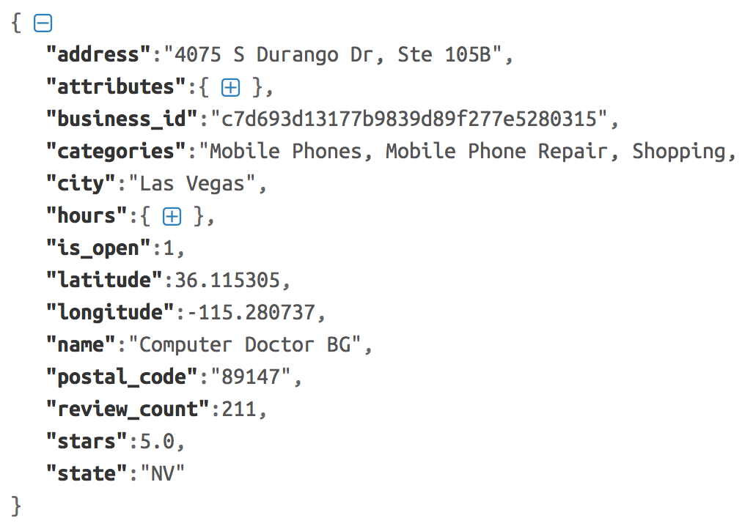
Project 3
Extra business information

Slide 8
Project 3
1. Task: Rating prediction
2. Data:
User ratings
Extra user information
Extra business information
3. Evaluation: RMSE

Slide 9
Project 3
We provide:
Rating data (‘train.csv’, ‘valid.csv’, ‘test.csv’), ‘stars’ column in ‘test.csv’ is set to 0.0 by default
User informations (‘user.json’)
Business informations (‘business.json’)
Sample code (Please replace STUDENT_ID by your own student id in the code)
Marking threshold based on the valid data will be released in tutorial 8.
You need to submit:
The prediction file with the ‘stars’ column filled.
A zip file that contains all the code for us to duplicate your result.
A brief report.
PS: Code for generating prediction files are included in the sample code

Slide 10
Project 3
Other information:
1. Due time: Apr. 24th 23:59 HK time
2. You are welcome to use any methods to make the prediction.
3. The methods taught in the class/tutorial (including previous ones) + some parameter tuning + some feature engineering are enough for you to get the full marks.
4. Late submission policy is same as project 1.
5. Your final grade is automatically calculated based on the RMSE score of your submission file with the gold mention labels. So please do not change the order.

